Slide 1
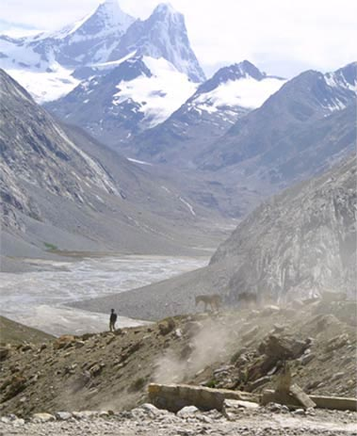
Fellowship of the Heart
Getting Started — the Four Connects, walked around the table on alternating evenings
Evening Series 2026–27 · at the Tittle home · v1.5E DRAFT
All Scripture: ESV · The Companion lesson plans carry the full scripts — these slides carry the room
1
Notes:
DECK TITLE · pre-session · DIVIDER
On screen as the room assembles on night one. All Scripture ESV; the plans carry the scripts; these slides carry the room — and these notes carry you.

Slide 2
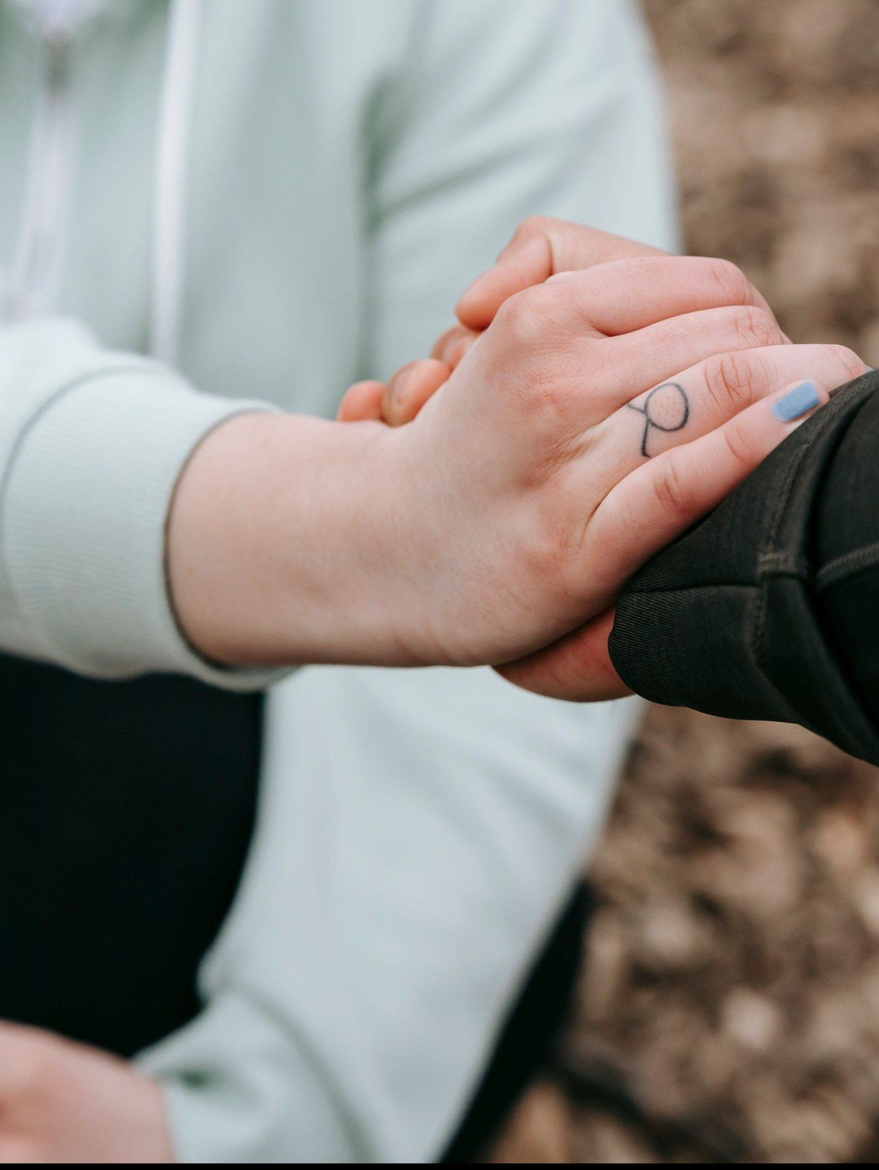
SESSION 6
Safe and Brave Together
Confession and restoration in an age-appropriate community
Quarter 1: Connect with Self & Others
71
Notes:
S6 · pre-session · DIVIDER
On screen through dinner and as the circle forms. Greet at the door — the slide holds the room.

Slide 3
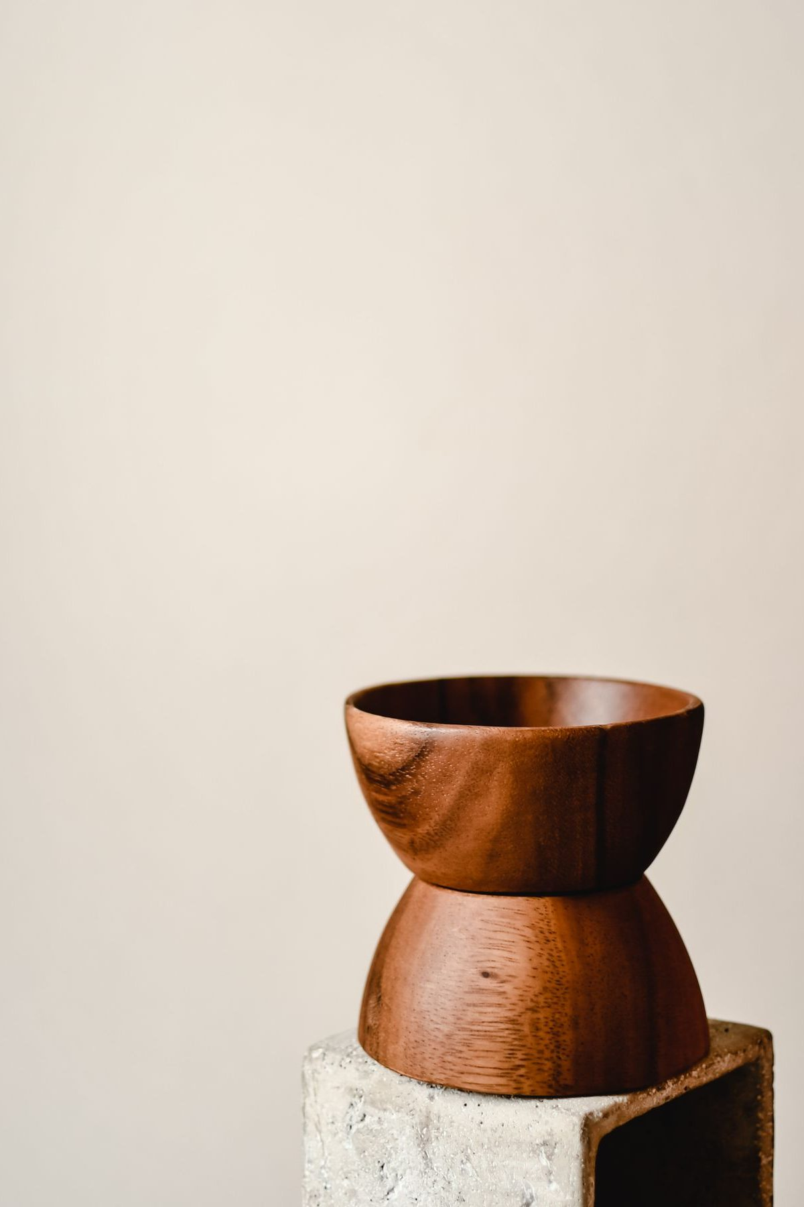
Session 6 — Tonight’s Road
1 Welcome and centering
2 Wk 5 check-in
3 James 5:16 and 1 John 1:9 — confession as architecture
4 Companion demo
5 Bridge to the split
6 Confession-and-restoration in pairs
7 Merge and shared blessing
8 Between-session practice + the room’s question
9 The Leader Feedback Round — both leaders
10 Closing container
72
Notes:
S6 · 7:00–8:30 · LEAD: BOTH LEADERS
BEATS:
1. Confession-and-restoration night — second-highest-risk after Weeks 3–4. Section 6 re-read beforehand; backup on call 6:30–11:00; tissues in every space.
2. Shape: open, check-in, 13-minute teaching, YOUR demo, bridge, 33-minute pair practice (Companion, then parents, then teens), merge and shared blessing, Examen plus Quarterly Pulse, feedback, close. Quarter 1 ends today.
3. Every parent was pre-briefed this week: own struggles, yes; the marriage's raw material, no; anything about the teen, never without asking the teen privately first.
GUARD: Frame it three times before the split: not specific sins — the place, the pattern, the pull.

Slide 4
Opening Container — the Eight Steps
1 Welcome — five minutes to open the container
2 Phones silenced and put away
3 Stand in a circle
4 One-word check-in — how you actually are, right now
5 Put out / bring in — set something down; bring a blessing in
6 Spoken commitment: “I am here. I am paying attention. I am willing to be moved.”
7 Opening prayer — “Holy Spirit, you are welcome here. Speak. We are listening.”
8 Sit. Begin.
73
Notes:
S6 · 7:00–7:08 · LEAD: CONTAINER HOLDER
BEATS:
1. Blessing; container reminder; nothing is required.
2. Say what today is NOT: we will not confess specific sins to each other in detail — scripture does not ask it, and neither do we.
3. Say what it IS: each of us names one place where we want to walk in greater honesty; the circle speaks a blessing of restoration; about three minutes per person; parents first, on purpose.
4. 'Teens, you choose your depth, and the pass is always real. The Spirit does the work; we hold the space.'

Slide 5

Week 5 Check-In
• “Last week we did the friendship audit and committed to one condition, one friendship, one week.”
• “One sentence about how that practice landed.” — an arranged parent starts
• Two or three voices is plenty — optional, no pressure
74
Notes:
S6 · 7:08–7:25 · LEAD: CONTAINER HOLDER
BEATS:
1. Ninety seconds: one sentence on how the one-friendship, one-condition practice landed; the arranged parent starts.
2. Take 2–3 voluntary contributions. Do not ask for more; move on.

Slide 6
Confession as Architecture
• Two verses, two angles — 1 John 1:9 is vertical: confession to God, with full assurance. James 5:16 is horizontal: confession to one another, for healing
• Most Christians live in 1 John 1:9 and never enter James 5:16. Tonight we enter it carefully and at age
• Patterns we hide from each other tend to keep their grip — bringing them into the light, in front of trusted people, is part of what breaks it
• Not detailed sin disclosure — each person names ONE place where they want to walk in greater honesty: the place, the pattern, the pull
• The parents go first in every pair — the older generation owes the younger the demonstration
• After each naming, the circle speaks a specific blessing of restoration — about three minutes per person
JAMES 5:16 · 1 JOHN 1:9
“Therefore, confess your sins to one another and pray for one another, that you may be healed. The prayer of a righteous person has great power as it is working.”
“If we confess our sins, he is faithful and just to forgive us our sins and to cleanse us from all unrighteousness.”
75
Notes:
S6 · 7:25–7:33 · LEAD: CONTENT PRESENTER
BEATS:
1. Read James 5:16 and 1 John 1:9 aloud, slowly, from the physical Bible.
2. Two angles: 1 John is vertical, with full assurance — the cross secured it (1 John 1:7); James is horizontal, in community, for healing. Most Christians never enter James 5:16; today we do, carefully and at age.
3. Give the examples of a 'place': the fear-over-trust pattern, the way I treat my brother, the performed faith, the resentment I keep feeding.
4. Say the parents-first rationale plainly: the older generation owes the younger the demonstration — a teen should never be asked to be braver than their parents were three minutes earlier.
GUARD: Not Catholic-sacramental confession — a Protestant small group doing what James 5:16 says. 'The place, not the details' — this is one of the three required framings; keep count.

Slide 7
Companion Demo
• The Lead Companion does the practice in front of the whole room — this sets the depth and the form
• One sentence: “The place where I want to walk in greater honesty is ______.” Real but not graphic
• Pause. A pre-arranged Co-Companion speaks a brief blessing of restoration back
• Receive it — no deflecting, no joking, no minimizing. “Thank you.”
• “That is the practice. You will do it in your pair — parents first, then teens. Yours doesn’t have to look like mine.”
76
Notes:
S6 · 7:33–7:39 · LEAD: CONTENT PRESENTER
BEATS:
1. Stand; eye contact across the room. 'The place where I want to walk in greater honesty is ___.' One place, specific, real but not graphic.
2. Pause; a PRE-ARRANGED Co-Companion speaks the three-sentence blessing back.
3. Receive it — no deflecting, no joking, no minimizing. 'Thank you.' Sit down.
4. Close: 'That is the practice. Parents first, then teens. Yours doesn't have to look like mine. Three minutes per person.'
SUB: The demo is the leader's own material. Name YOUR one real place, written and rehearsed this week — never borrow the founder's — and arrange your blessing-giver before the session.

Slide 8
Bridge to the Split
1 “Take what helps from the prompts. You don’t have to use any of them.”
2 The blessing card — specific, short, witnessed: “In the name of Jesus, we pray restoration over...”
3 “The container holds. Nothing leaves the pair. Not even back to the main room. Especially this week.”
• The order holds too: your Companion first, then the parents, then the teens
• “Teens — your depth is yours, and pass is always allowed.”
77
Notes:
S6 · 7:39–7:40 · LEAD: CONTENT PRESENTER · TRANSITION
BEATS:
1. Three things: the prompts are scaffolding — use or ignore; the blessing card has the form — specific, short, witnessed; the container holds — nothing leaves the pair, especially this week.
2. Restate the order: Companion first, then the parents, then the teens — teens' depth is theirs; pass always allowed.
3. Pray and send. Ten or fewer: 'We're staying right here — one circle, same order, same rules.'

Slide 9
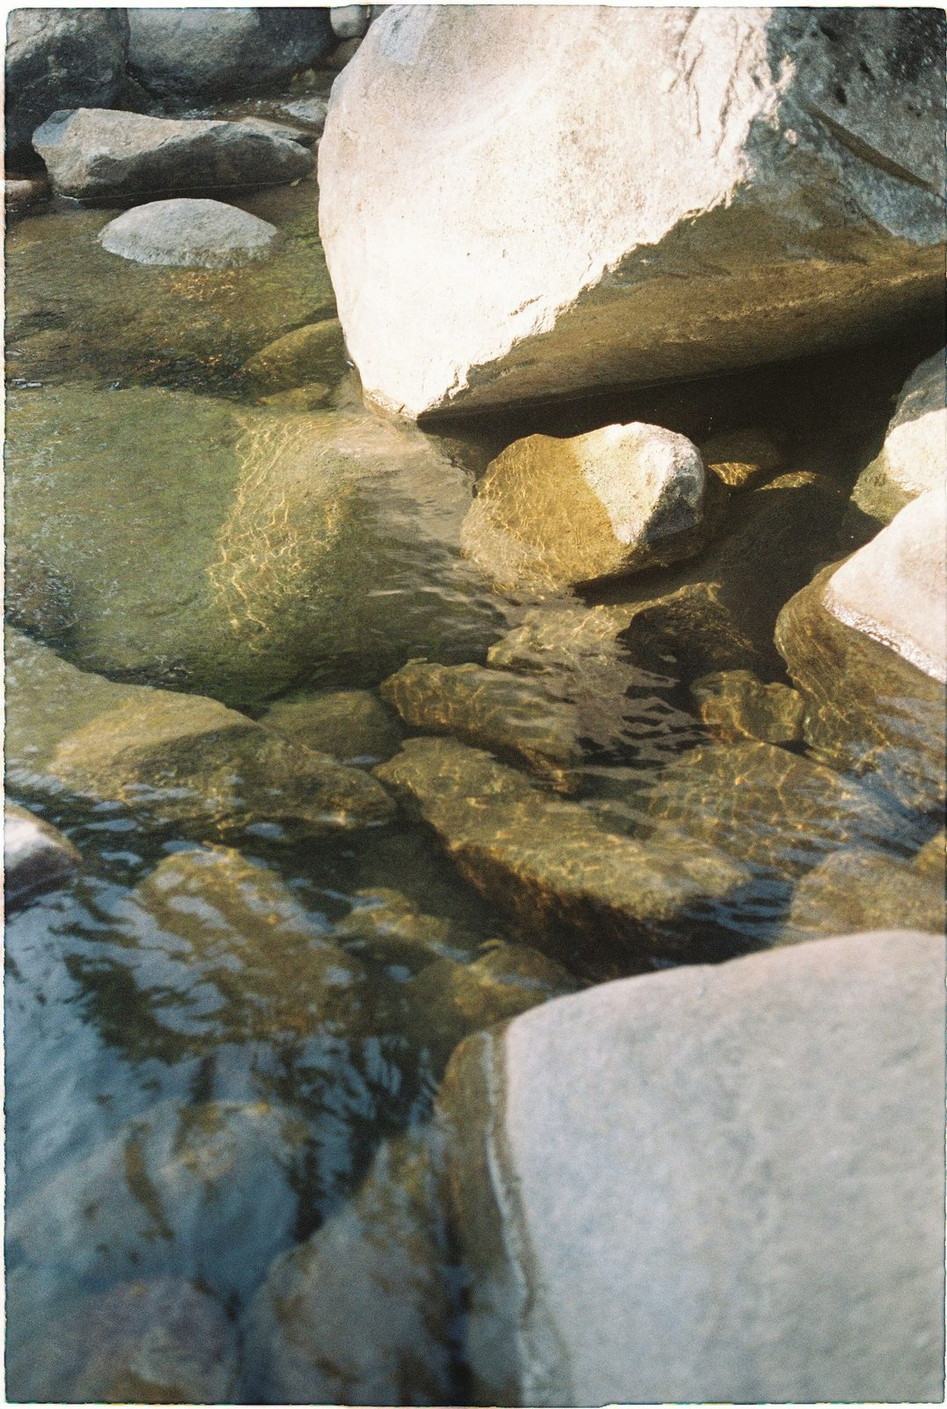
Confession and Restoration in pairs
• Ninety seconds of silence to settle in — the silence is part of the practice
1 The leadsanion goes first — names one place, receives a blessing
2 The parents next — the arranged parent opens; own struggles only, within the rails
3 The teens — each names one place at whatever depth they choose. Pass is real, honored without a flicker
• The form: “The place where I want to walk in greater honesty before God is ______.”
• After each naming, a brief specific blessing — a teen blessing their own parent is one of the best things this night can produce
• Closing silence — “We have named real things tonight. Let’s sit with what was said.”
78
Notes:
S6 · 7:40–8:16 · LEAD: CONTENT PRESENTER · PAIRS
BEATS:
1. The Companion opens with ninety seconds of silence, then goes first (3 min) and receives the pre-assigned blessing.
2. Parents next, arranged parent opening, within the rails; then the teens at their own depth — pass honored without a flicker. A teen blessing their own parent is one of the best things this night produces.
3. Pace: three minutes per person; a three-family pair runs 2.5 from the start, not discovered at 5:03. Never skip anyone — compress before you cut.
4. Close with one to two minutes of held silence.
GUARD: Detailed sin disclosure gets the gentle redirect — 'the practice is the place, not the details.' A parent drifting past the rails: 'The rest belongs to the 1:1.' Watch the teens' faces during the parents' turns, not the confessing parent — weight received is a Settle Protocol matter; check in before anyone leaves the building.

Slide 10
Merge and Shared Blessing
• What happened in your pair stays in your pair
• “One word about what tonight was like in your body. ‘Heavy.’ ‘Lighter.’ ‘Held.’ ‘Tender.’ ‘Surprised.’” — an arranged parent starts
• Then one shared blessing of restoration over the whole room — “Hands up if you want”
• “We pray restoration into every place that was named... Holy Spirit, walk these brothers and sisters home.”
79
Notes:
S6 · 8:16–8:20 · LEAD: CONTENT PRESENTER
BEATS:
1. Settle the room. One word each on what today was like IN YOUR BODY — 'heavy', 'lighter', 'held', 'tender'; the arranged parent starts.
2. Speak the one corporate blessing of restoration over the whole room (script in the plan): real places named, restoration prayed into each, courage carried to evenings morning when the place will still be the place.
GUARD: Nothing from any pair is asked for or repeated.

Slide 11

Homework — Two Weeks, Four Parts — the Five-Minute Examen
• The Five-Minute Examen — five minutes with God each evening, before bed, carried through the quarter break
1 Thank Him for one specific thing from the day
2 Notice one place where you saw God moving
3 Ask Him about one place where you walked in less honesty than you wanted to today — just notice. No fixing
• The Quarterly Pulse goes home tonight — three questions, five minutes, sign it or leave it anonymous
• It comes back to the bin at the door at Week 7
80
Notes:
S6 · 8:20–8:24 · LEAD: CONTENT PRESENTER
BEATS:
1. Parent Co-Companion leads. Five-Minute Examen each evening: thank Him for one specific thing; notice one place you saw God moving; ask Him about one place you walked in less honesty than you wanted today.
2. No fixing — just notice; the Spirit does the work. Carried through the quarter break.
3. Quarterly Pulse (H6.3) goes home today: three questions, five minutes, signed or anonymous — back in the bin at the Week 7 door.

Slide 12
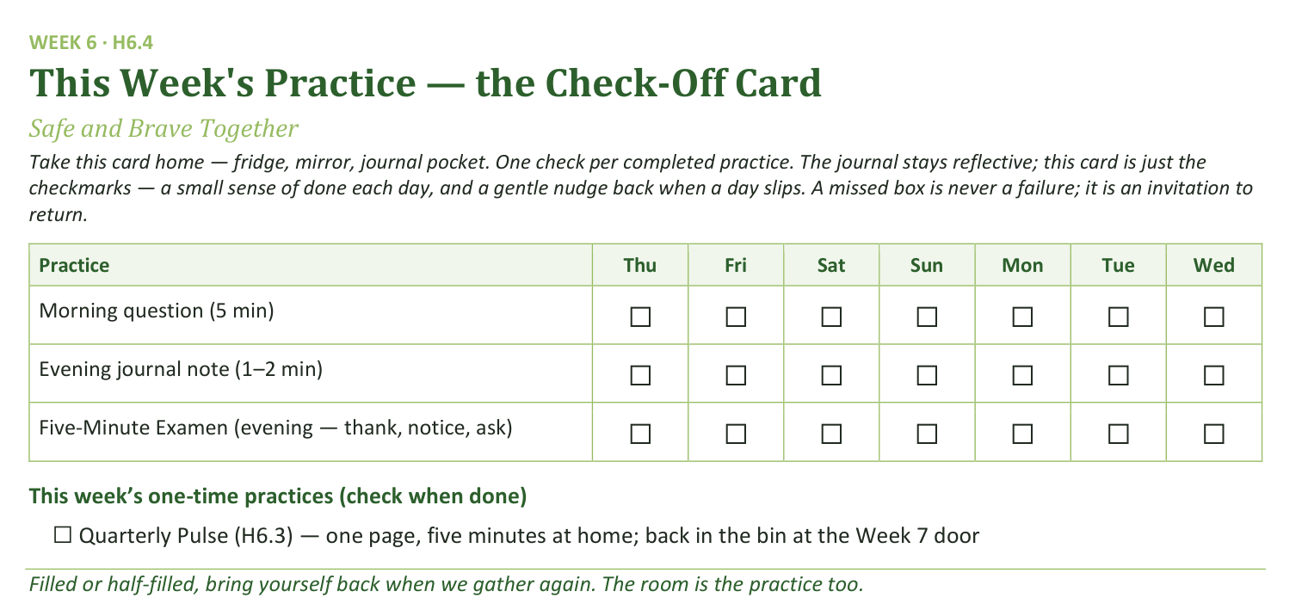
Your Take-Home Card — This Session’s Practice
Handed out now — fridge, mirror, journal pocket.
81
Notes:
S6 · 8:20–8:24 · LEAD: CONTENT PRESENTER
BEATS:
1. Check-off card (H6.4): morning question, evening note, nightly Examen; one-time box for the Pulse.
2. 'Filled or half-filled, bring yourself back when we gather again.'
CUES: Rides inside the practice block — make sure every family leaves with a Pulse page.

Slide 13
Three Questions, Carried Home
Every week we close the same way — the leader’s reflection, then the room’s. Tonight closes a whole quarter, so the same questions come home for all of us:
1 What’s working well that we ought to keep doing next quarter?
2 What could we do differently that would make things even better?
3 What would you tell somebody else about what this group is like?
No paper. Nothing to prepare. The group, never any one person. First night back, we talk.
82
Notes:
S6 · 8:20–8:24 · LEAD: CONTENT PRESENTER
BEATS:
1. After the Examen and the Pulse: 'three questions go home tonight — no paper, no deadline, nothing to prepare.' Frame it as the round the room already knows, grown one size: the leader's questions, asked of all of us.
2. Read the three slowly. Then the runway for the quiet ones: 'some of you think best in the quiet — that's why they go home two weeks early.'
GUARD: the group, never any one person — said warmly, once. An offer, never an assignment; the journal's Week 6 page carries the questions for anyone who wants to write toward them.
ADVANCE CUE: after 'first night back, we talk.'

Slide 14
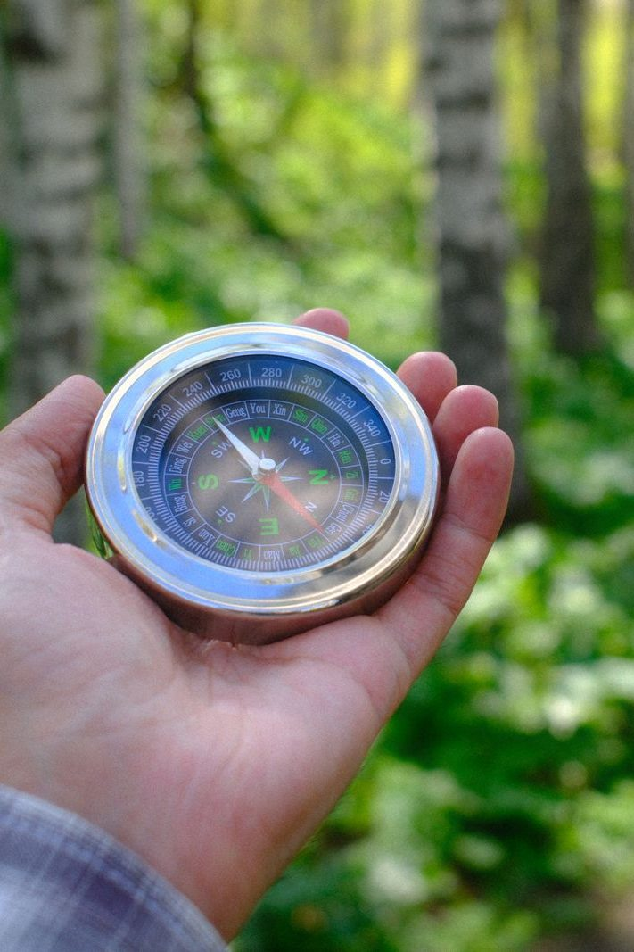
The Leader Feedback Round
• Two rounds, same as every session — the container holder first, then the content presenter: three things each
– “What I think went well tonight: ______”
– “What I’d do differently next time: ______”
– “If I were to teach tonight’s process to someone, I would tell them: ______”
• Then the room — the same two questions about tonight
• The leaders receive without defending — “thank you” is the whole response
83
Notes:
S6 · 8:24–8:28 · LEAD: BOTH LEADERS
BEATS:
1. Your three things first; then the room's two questions; receive without defending — 'thank you.'
2. On a night this heavy, read the room — a quiet, brief running usually lands better than skipping: the leader asking 'what would you do differently?' minutes after everyone confessed is the same muscle the room just practiced.

Slide 15
Closing the Container + Aaronic Blessing
• We close the way we opened — the container, six steps:
1 Stand again — same circle, same posture as the open
2 One-word landing — compare it to your opening word
3 The one thing you are taking from tonight
4 The one practice — committed aloud, or modified to one you will actually keep
5 Blessings — specific, witnessed, short
6 Closing prayer — and the Aaronic blessing, spoken over each other, face to face
THE AARONIC BLESSING — NUMBERS 6:24–26
“The Lord bless you and keep you;
the Lord make his face to shine upon you, and be gracious to you;
the Lord lift up his countenance upon you, and give you peace.”
84
Notes:
S6 · 8:28–8:30 · LEAD: CONTAINER HOLDER
BEATS:
1. 'Today's container is heavier than usual. We hold it tighter than usual.' Nothing leaves the pair.
2. Name the follow-up door: email, text, knock — the team is here.
3. Aaronic blessing. 'Go gently. Today closes the quarter — carry the Examen through the break; bring the Pulse back to the Week 7 door.'
CUES: Do not pack up — stay accessible at least ten minutes; this night produces door conversations more than any other.

Slide 16
Quarter 2
Connect with God
Weeks 7–11 · Five Wednesdays · PROAPT, the Garden, Any Doubts? · ends at the year’s midpoint
85
Notes:
QUARTER 2 · pre-session · DIVIDER
On screen as families arrive for the quarter's first evenings. Greet at the door — the slide holds the room.

